Slide 1

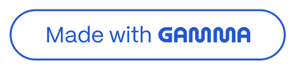
Spam Message Prediction using Machine Learning
Towards a Spam-Free Inbox

Slide 2
Introduction
The aim of this project is to classify text messages as 'spam' or 'ham' (not spam). Machine learning models are trained on labeled data to predict whether a message is spam.
Specifically, the project seeks to: Analyze and preprocess email text data to extract meaningful features.
Train a classification model using these features to learn the distinguishing characteristics of spam and ham.
Evaluate the model's performance in accurately identifying spam emails while minimizing false positives.

Slide 3
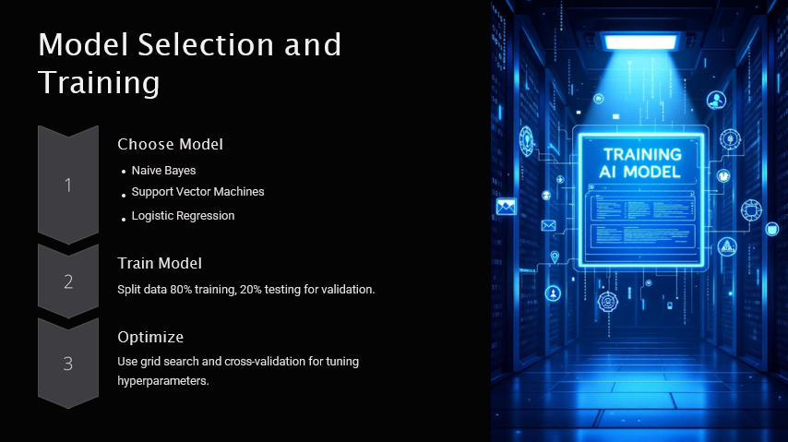

Slide 4
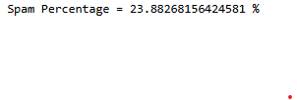
Dataset Overview
The dataset spammailAssasin consists of SMS messages labeled as 'spam' or 'ham'.
Total messages: 5572
Spam: 747
Ham: 4825

Slide 5
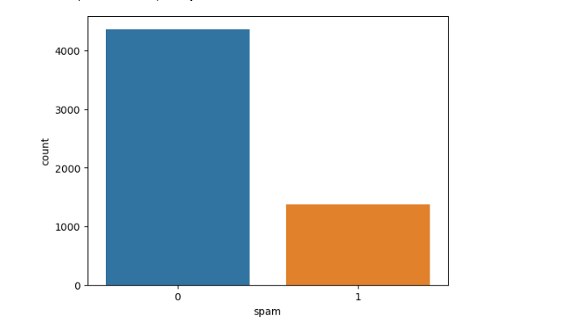
Spam vs Ham Distribution

Slide 6
Data Preprocessing
Cleaned Data:
Handled missing values.
Removed duplicates.
Transformed Text:
Lowercased.
Tokenized (split into words).
Removed non-alphanumeric characters, stopwords, and punctuation.
Stemmed words (reduced to root form).
Encoded Labels:
Converted 'spam'/'ham' to 0/1.
Added Feature:
Calculated email length (number of characters)

Slide 7
Model Training
Trained multiple models such as:
- Logistic Regression
- Naive Bayes
- Support Vector Machine (SVM)
Best results were observed with Logistic Regression.

Slide 8
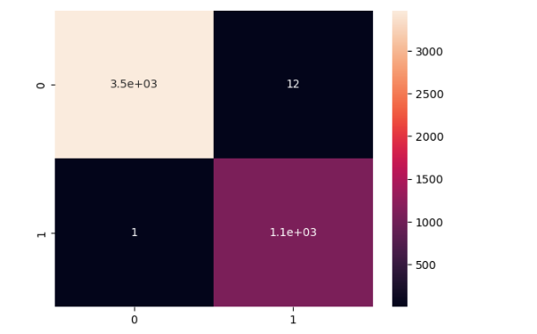
Did the Computer Get It Right?
This picture helps us see how well the computer did at sorting emails.
The corners are where the computer got it right.
This corner (point to top left) is where the computer correctly said an email was 'not spam.'
This corner (point to bottom right) is where the computer correctly said an email was 'spam.'
The other boxes are where the computer made mistakes.
This box (point to top right) is where the computer wrongly said a 'not spam' email was 'spam.'
This box (point to bottom left) is where the computer wrongly said a 'spam' email was 'not spam.'

Slide 9
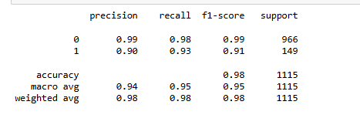
Model Evaluation
Evaluation metrics:
- Accuracy
- Precision
- Recall
- F1 Score
Model Accuracy: ~98%

Slide 10
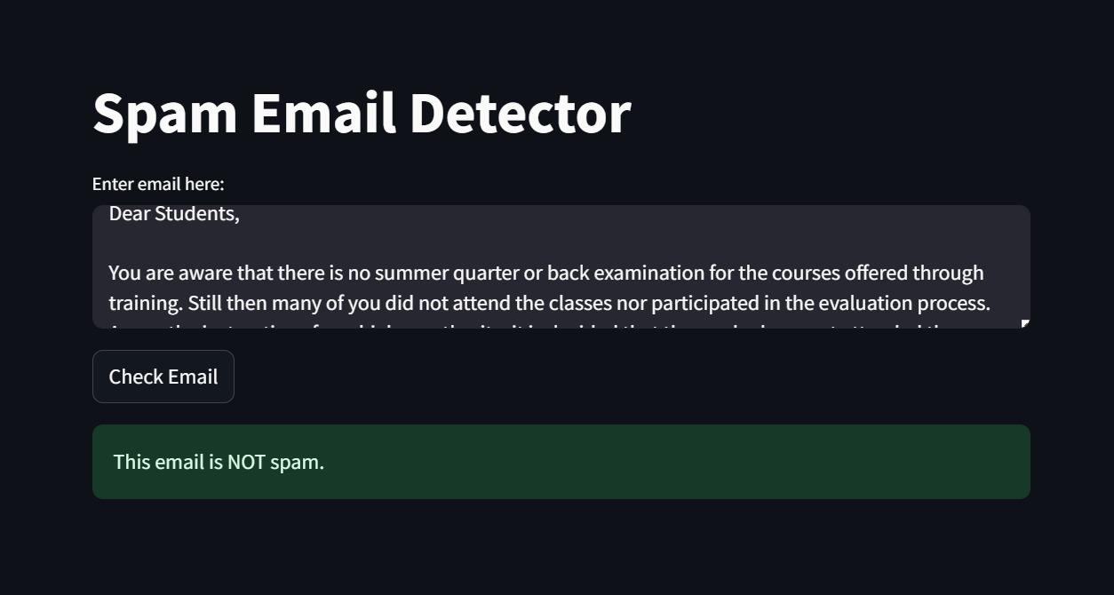
Deployment with Streamlit
To make our spam filter usable, we deployed it as a web application using Streamlit.
Stream lit allows us to create interactive web apps from Python scripts easily.
Users can input an email message into the application.
The application uses our trained machine learning model to predict whether the email is spam or ham.
This provides a user-friendly way to interact with the spam detection system.

Slide 11
Conclusion
In conclusion, this project successfully developed a machine learning model that can accurately classify emails. We showed that Logistic Regression is a good choice for this type of problem. We also created a practical application that can help users filter spam. This work contributes to making email management easier and safer.

